Slide 1
Solving Problems by Searching
Chapter 3

Slide 2
Outline
Problem-solving agents
Problem types
Problem formulation
Example problems
Basic search algorithms

Slide 3
8-puzzle problem
2
8
3
1
2
3
1
6
4
8
4
7
5
7
6
5
  state description
    3-by-3 array: each cell contains one of 1-8 or blank symbol
  two state transition descriptions
    8×4 moves: one of 1-8 numbers moves up, down, right, or left
    4 moves: one black symbol moves up, down, right, or left
  The number of nodes in the state-space graph:
    9! ( = 362,880 )

Slide 4
Formulating the State Space
For huge search space we need,
  Careful formulation
  Implicit representation of large search graphs
  Efficient search method

Slide 5

8-queens problem
Place 8-queens in the position such that no queen can attack the others

Slide 6
Implicit State-Space Graphs
Basic components to an implicit representation of a state-space graph
    1. Description of start node
    2. Actions: Functions of state transformation
    3. Goal condition: true-false valued function
Types of search process
  Uninformed search: no problem specific information
  Heuristic search: existence of problem-specific information

Slide 7
3. Breadth-First Search
Procedure
  1. Apply all possible operators (successor function) to the start node.
  2. Apply all possible operators to all the direct successors of the start node.
  3. Apply all possible operators to their successors till goal node found.
  ♠ Expanding : applying successor function to a node

Slide 8
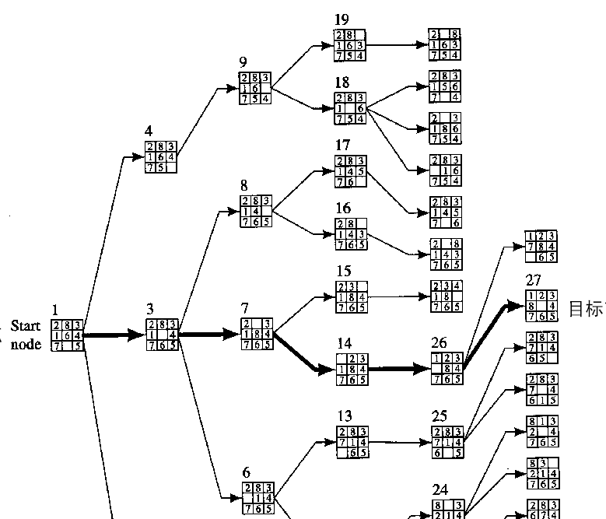

Slide 9
Breadth-First Search
Advantage
  Finds the path of minimal length to the goal.
Disadvantage
  Requires the generation and storage of a tree whose size is exponential the the depth of the shallowest goal node
Uniform-cost search [Dijkstra 1959]
  Expansion by equal cost rather than equal depth

Slide 10

Problem-solving agents

Slide 11

Example: Travel in Romania

Slide 12
Example: Travel in Romania
On holiday in Romania; currently in Arad.
Flight leaves tomorrow from Bucharest
Formulate goal:
  be in Bucharest
Formulate problem:
  states: various cities
  actions: drive between cities
Find solution:
  sequence of cities, e.g., Arad, Sibiu, Fagaras, Bucharest

Slide 13
Problem types
Deterministic, fully observable → single-state problem
  Agent knows exactly which state it will be in; solution is a sequence
Non-observable → sensorless problem (conformant problem)
  Agent may have no idea where it is; solution is a sequence
Nondeterministic and/or partially observable → contingency problem
  percepts provide new information about current state
  often interleave, search, execution
Unknown state space → exploration problem

Slide 14
Single-state problem formulation
A problem is defined by four items:
initial state e.g., "at Arad“
actions or successor function S(x) = set of action–state pairs
  e.g., S(Arad) = {<Arad → Zerind, Zerind>, … }
goal test, can be
  explicit, e.g., x = "at Bucharest"
  implicit, e.g., Checkmate(x)
path cost (additive)
  e.g., sum of distances, number of actions executed, etc.
  c(x,a,y) is the step cost, assumed to be ≥ 0
A solution is a sequence of actions leading from the initial state to a goal state

Slide 15
Selecting a state space
Real world is very complex generally
  → state space must be abstracted for problem solving
(Abstract) state = set of real states
(Abstract) action = complex combination of real actions
  e.g., "Arad → Zerind" represents a complex set of possible routes, detours, rest stops, etc.
For guaranteed realizability, any real state "in Arad“ must get to some real state "in Zerind“
(Abstract) solution =
  set of real paths that are solutions in the real world
Each abstract action should be "easier" than the original problem

Slide 16
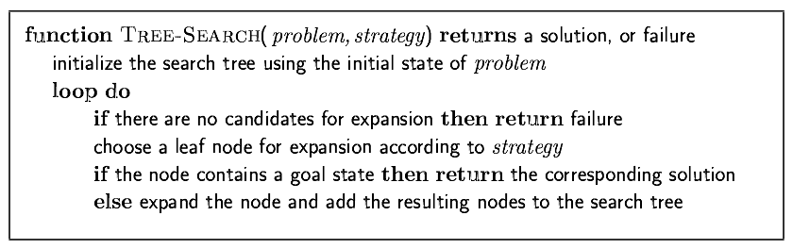
Tree search algorithms
Basic idea:
  offline, simulated exploration of state space by generating successors of already-explored states (a.k.a.~expanding states)

Slide 17


Tree search example

Slide 18

Tree search example

Slide 19

Tree search example

Slide 20

Implementation: general tree search

Slide 21

Implementation: states vs. nodes
A state is a (representation of) a physical configuration
A node is a data structure constituting part of a search tree includes state, parent node, action, path cost g(x), depth
The Expand function creates new nodes, filling in the various fields and using the SuccessorFn of the problem to create the corresponding states.

Slide 22
Search strategies
A search strategy is defined by picking the order of node expansion
Strategies are evaluated along the following dimensions:
  completeness: does it always find a solution if one exists?
  time complexity: number of nodes generated
  space complexity: maximum number of nodes in memory
  optimality: does it always find a least-cost solution?
Time and space complexity are measured in terms of
  b: maximum branching factor of the search tree
  d: depth of the least-cost solution
  m: maximum depth of the state space (may be ∞)

Slide 23
Uninformed search strategies
Uninformed search strategies use only the information available in the problem definition
Breadth-first search
Uniform-cost search
Depth-first search
Depth-limited search
Iterative deepening search

Slide 24

Breadth-first search
Expand shallowest unexpanded node
  fringe is a FIFO queue, i.e., new successors go at end
Implementation:

Slide 25

Breadth-first search
Expand shallowest unexpanded node
  fringe is a FIFO queue, i.e., new successors go at end
Implementation:

Slide 26

Breadth-first search
Expand shallowest unexpanded node
  fringe is a FIFO queue, i.e., new successors go at end
Implementation:

Slide 27
Chapter 3 Uninformed Search
Problem-solving agents
Problem types
Problem formulation
Example problems
Basic search algorithms

Slide 28

Breadth-first search
Expand shallowest unexpanded node
  fringe is a FIFO queue, i.e., new successors go at end
Implementation:

Slide 29
Properties of breadth-first search
Complete? Yes (if b is finite)
Time? 1+b+b²+b³+… +b^{d} + b(b^{d}-1) = O(b^{d+1})
Space? O(b^{d+1}) (keeps every node in memory)
Optimal? Yes (if cost = 1 per step)
Space is the bigger problem (more than time)

Slide 30
Uniform-cost search
Expand least-cost unexpanded node
  fringe = queue ordered by path cost
Equivalent to breadth-first if step costs all equal
Space? # of nodes with g ≤ cost of optimal solution, O(b^{ceiling(C*/ ε)})
Optimal? Yes – nodes expanded in increasing order of g(n)
Complete? Yes, if step cost ≥ ε
Time? # of nodes with g ≤ cost of optimal solution, O(bceiling(C*/ ε)) where C* is the cost of the optimal solution
Implementation:

Slide 31

Depth-first search
Expand deepest unexpanded node
  fringe = LIFO queue, i.e., put successors at front
Implementation:

Slide 32

Depth-first search
Expand deepest unexpanded node
  fringe = LIFO queue, i.e., put successors at front
Implementation:

Slide 33

Depth-first search
Expand deepest unexpanded node
  fringe = LIFO queue, i.e., put successors at front
Implementation:

Slide 34

Depth-first search
Expand deepest unexpanded node
  fringe = LIFO queue, i.e., put successors at front
Implementation:

Slide 35

Depth-first search
Expand deepest unexpanded node
  fringe = LIFO queue, i.e., put successors at front
Implementation:

Slide 36

Depth-first search
Expand deepest unexpanded node
  fringe = LIFO queue, i.e., put successors at front
Implementation:

Slide 37

Depth-first search
Expand deepest unexpanded node
  fringe = LIFO queue, i.e., put successors at front
Implementation:

Slide 38

Depth-first search
Expand deepest unexpanded node
  fringe = LIFO queue, i.e., put successors at front
Implementation:

Slide 39

Depth-first search
Expand deepest unexpanded node
  fringe = LIFO queue, i.e., put successors at front
Implementation:

Slide 40

Depth-first search
Expand deepest unexpanded node
  fringe = LIFO queue, i.e., put successors at front
Implementation:

Slide 41

Depth-first search
Expand deepest unexpanded node
  fringe = LIFO queue, i.e., put successors at front
Implementation:

Slide 42

Depth-first search
Expand deepest unexpanded node
  fringe = LIFO queue, i.e., put successors at front
Implementation:

Slide 43
Properties of depth-first search
Complete? No: fails in infinite-depth spaces, spaces with loops
  Modify to avoid repeated states along path
    → complete in finite spaces
Time? O(b^{m}): terrible if m is much larger than d
  but if solutions are dense, may be much faster than breadth-first
Space? O(bm), i.e., linear space!
Optimal? No

Slide 44

Depth-limited search
= depth-first search with depth limit l,
i.e., nodes at depth l have no successors
Recursive implementation:

Slide 45

Iterative deepening search

Slide 46
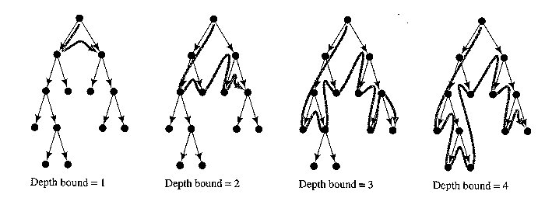
5. Iterative Deepening
Advantage
  Linear memory requirements of depth-first search
  Guarantee for goal node of minimal depth
Procedure
  Successive depth-first searches are conducted – each with depth bounds increasing by 1

Slide 47
Iterative deepening search
Number of nodes generated in a depth-limited search to depth d with branching factor b:
N_{DLS} = b⁰ + b¹ + b² + … + b^{d-2} + b^{d-1} + b^{d}
Number of nodes generated in an iterative deepening search to depth d with branching factor b:
N_{IDS} = (d+1)b⁰ + d b^¹ + (d-1)b^² + … + 3b^{d-2} +2b^{d-1} + 1b^{d}
For b = 10, d = 5,
  N_{DLS} = 1 + 10 + 100 + 1,000 + 10,000 + 100,000 = 111,111
  N_{IDS} = 6 + 50 + 400 + 3,000 + 20,000 + 100,000 = 123,456
Overhead = (123,456 - 111,111)/111,111 = 11%

Slide 48
Iterative deepening search
Complete? Yes
Time? (d+1)b⁰ + d b¹ + (d-1)b² + … + b^{d} = O(b^{d})
Space? O(bd)
Optimal? Yes, if step cost = 1

Slide 49

Summary of algorithms

Slide 50

Repeated states
Failure to detect repeated states can turn a linear problem into an exponential one!

Slide 51

Graph search

Slide 52
Summary
Problem formulation usually requires abstracting away real-world details to define a state space that can feasibly be explored
Variety of uninformed search strategies
Iterative deepening search uses only linear space and not much more time than other uninformed algorithms

